Slide 1

SWASTH - By Team FAUG
Final Project Web Design
Presented By:
Felicia Francis Sequeira (002744669)
Aditya Raj(002774709)
Uday Kiran Kolluru(002738927)
Srinivasa Pavan Ganesh Vasa(002709131)

Slide 2
Introduction
The main aim of this project is to keep track of calories intake and outtake and schedule trainer sessions.
Tech Stack used:
NodeJS
Express
MongoDB
ReactJS
Redux
Axios
ANT-D Forms and validations
Bearer Token
JWT for authentication and authorization.
Hash Passwords
Progressive charts using ANT-D for analysis.

Slide 3





Overview
Login or SignUp : User/Trainer/Admin
Calorie Tracker : Helps to track calorie intake and outtake based on calories in food and exercise.
Trainer Form : A user can apply for a trainer position.
Admin Page : Admin approves/removes/rejects an applicant for trainer position
Appointment Booking : A user can book an appointment with a trainer for fitness sessions.

Slide 4
Features
Register, Login and Logout Functionality.
Redirecting to the Role specific screen by authenticating.
CRUD operations on the calorie logs of the user.
Filter data of the calories according to type and time range.
A Progressive chart to show the calories intake and burnt in the selected range.
A User can view all the available trainers and can request to join the session.
An interested User can apply for trainer position and Admin can verify and accept them into the system.
Trainer can view all the pending sessions and accept them.
Admin can moderate the system by block & reject actions.

Slide 5
Contributions
Uday Kiran Kolluru: Login/Logout, Calorie Tracker
Felicia Sequeira: Calorie Tracker
Aditya Raj: Booking User appointments
Pavan Ganesh: Managing Trainer Appointments
Everyone contributed to UI Design

Slide 6
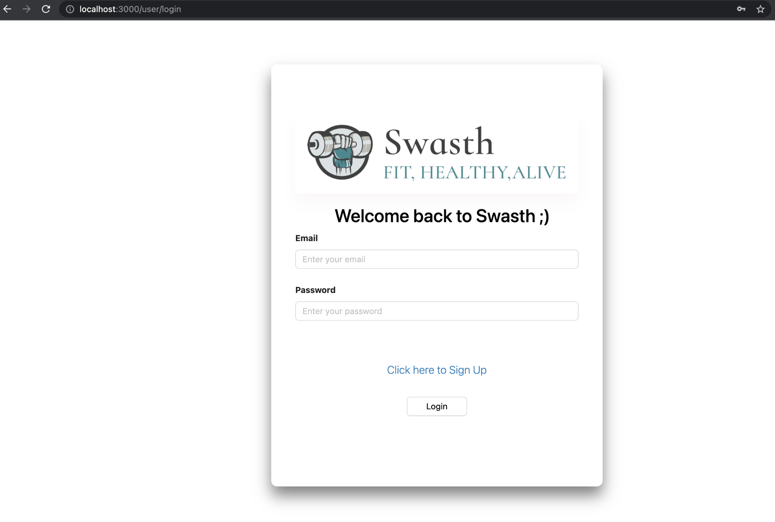
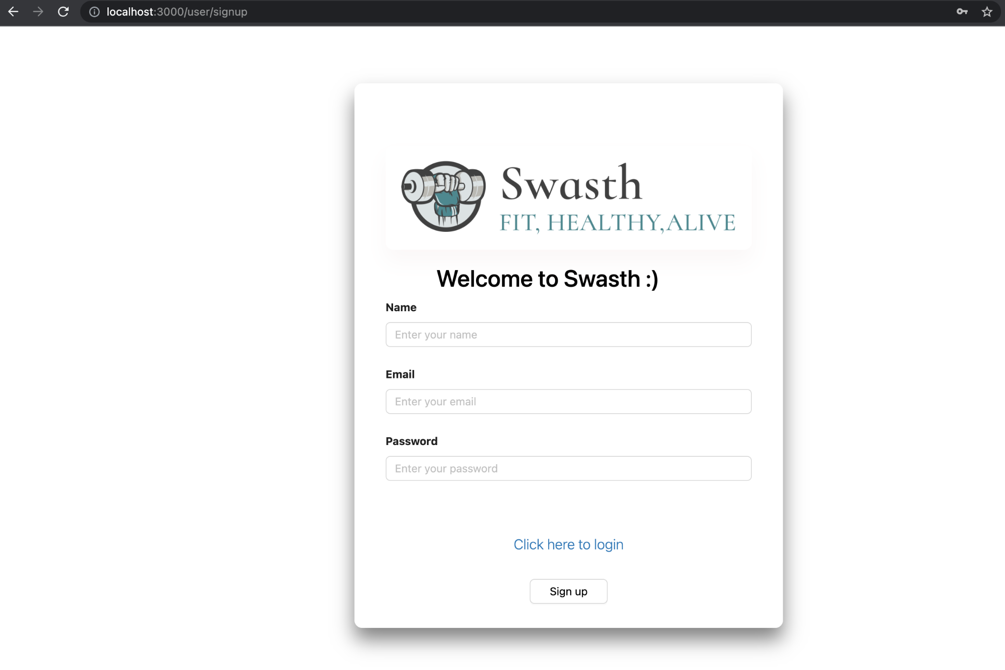
Screenshots
Login/Register

Slide 7
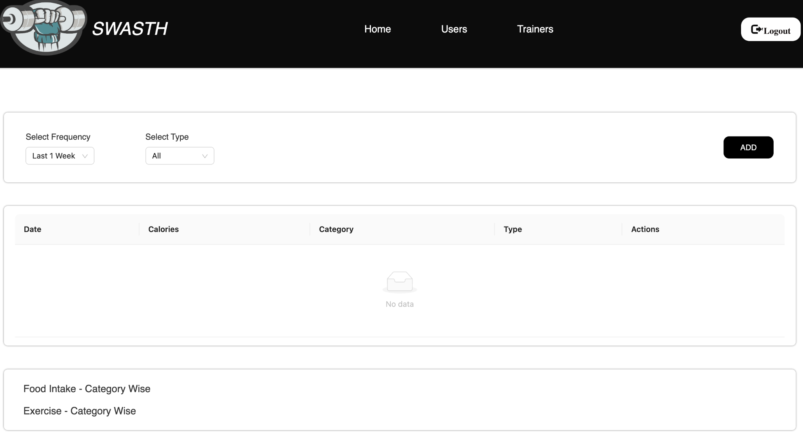
Screenshots
Admin WorkArea

Slide 8
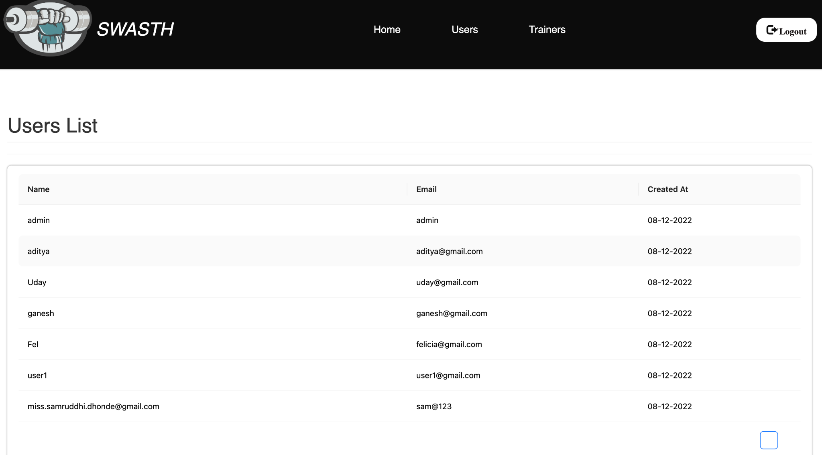
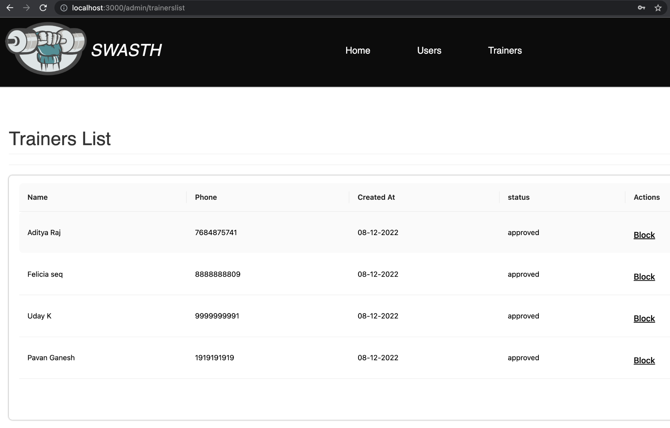
Screenshots
Admin WorkArea

Slide 9
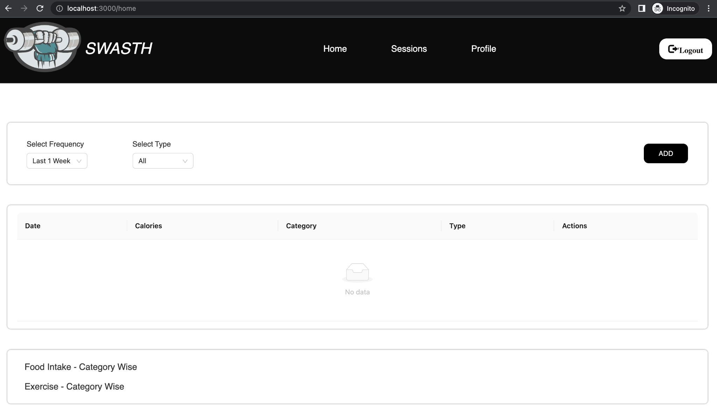
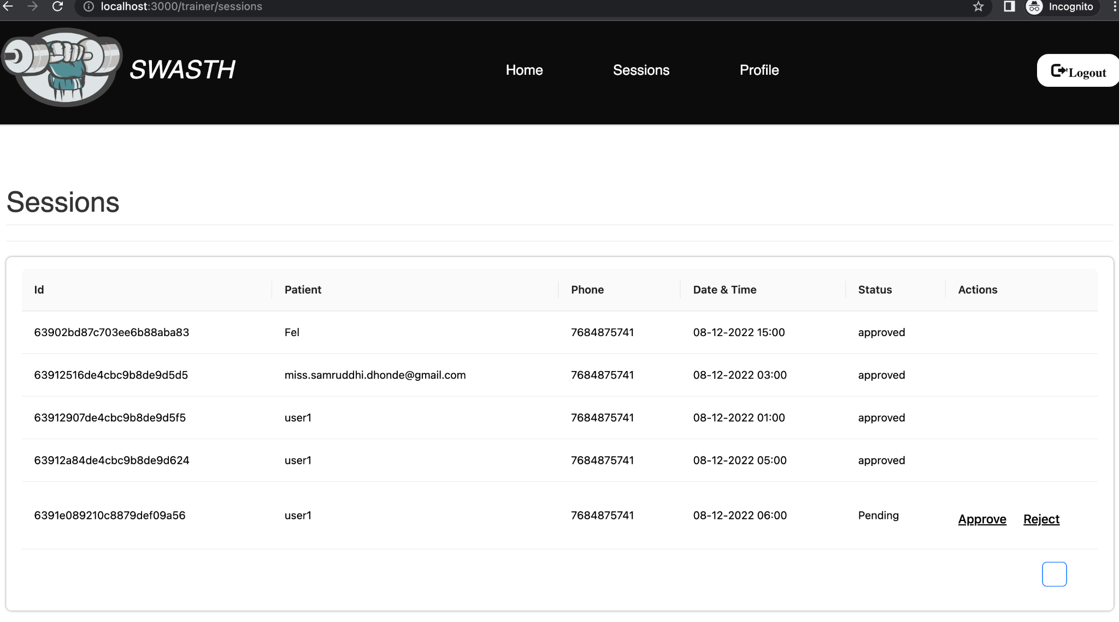
Screenshots
Trainer WorkArea

Slide 10
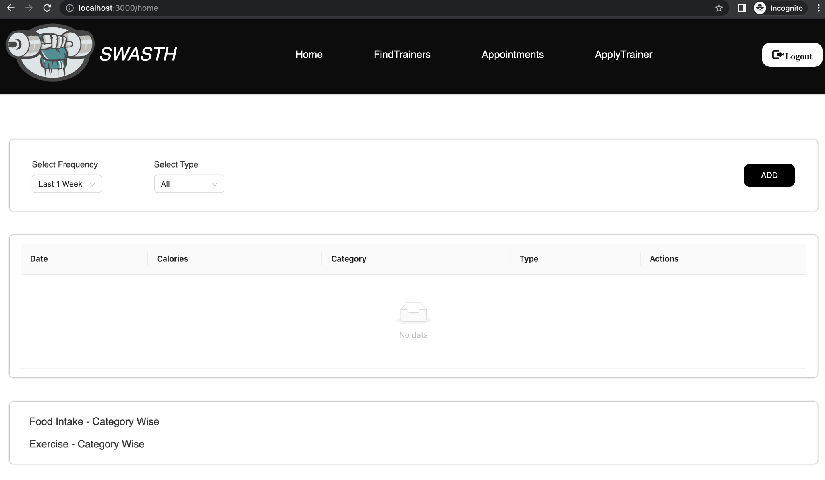
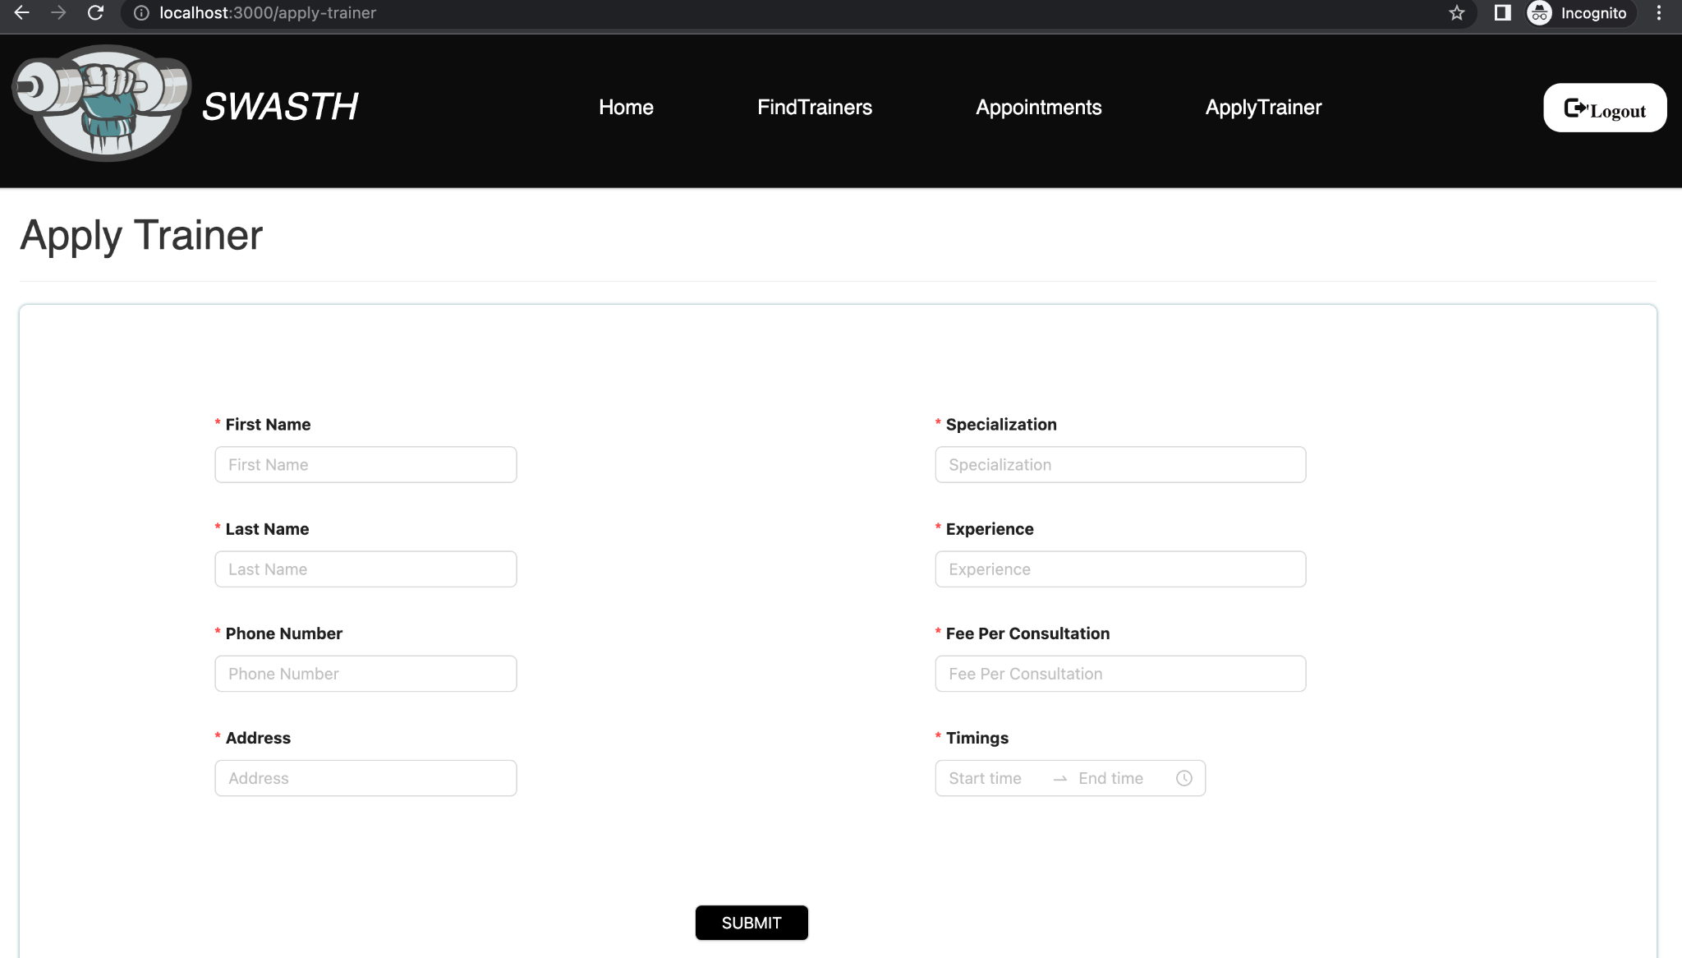
Screenshots
User WorkArea

Slide 11
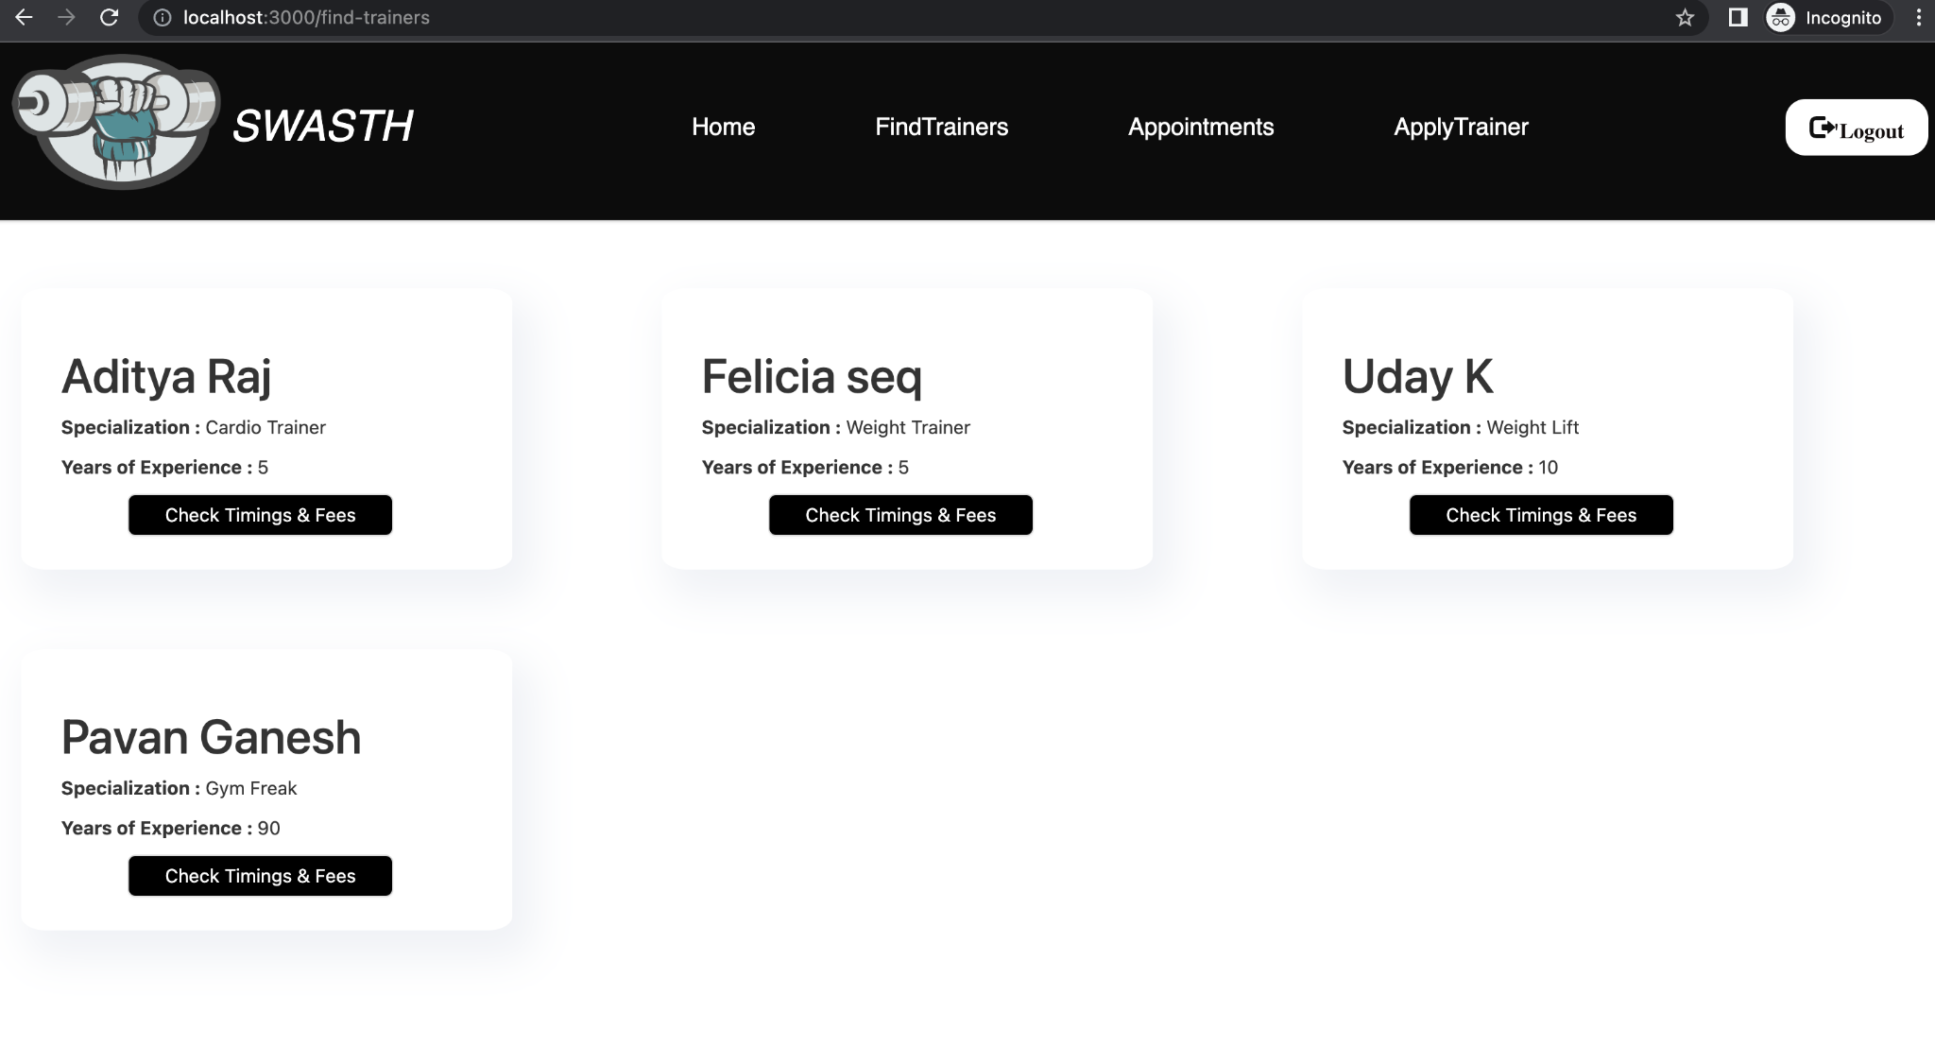
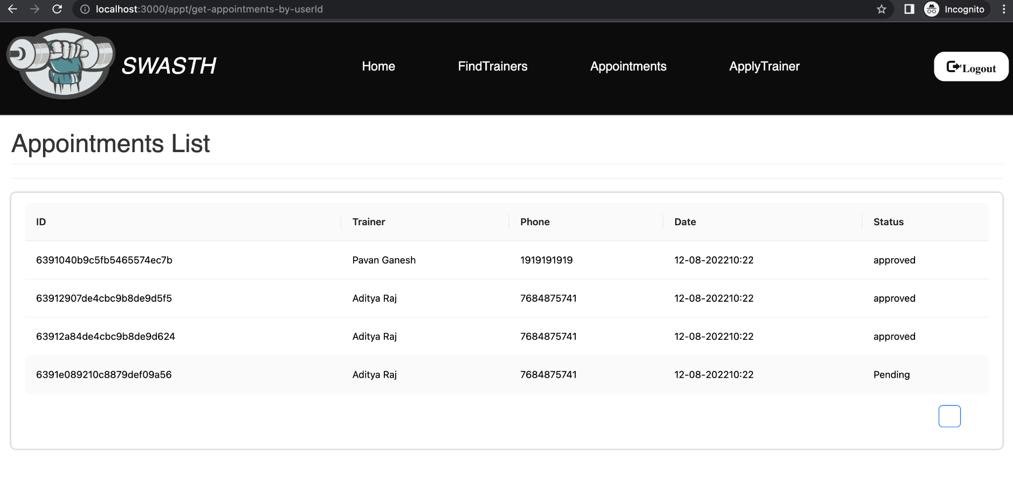
Screenshots
User WorkArea

Slide 12
References
https://developer.mozilla.org/en-US/docs/Web/JavaScript/Guide
https://jwt.io
https://replit.com/@amuthanarulraj

